Slide 1
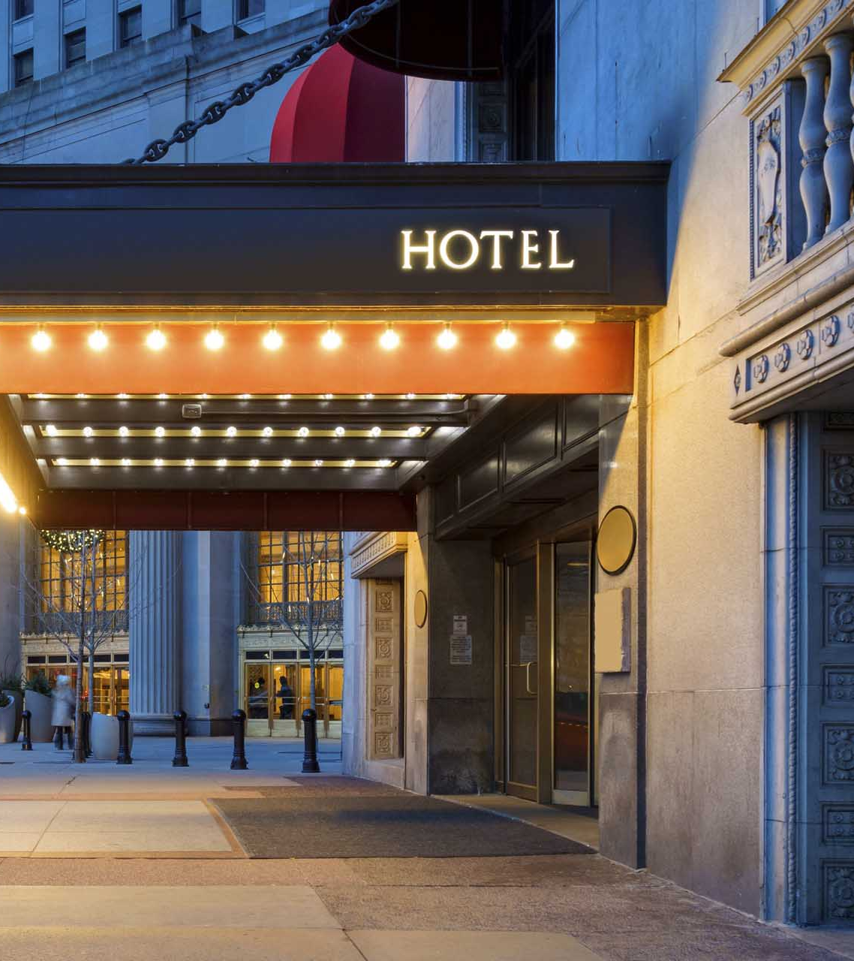
Hotel Cancellation Analysis and Prediction
IST 687 Intro to Data Science Group 5
Gabriella Caggiano
Reetodeep Hazra
Prateek Kumar Kumbar
Qiaoyi(Joy) Liu
Yash Shah

Slide 2
Project Goals
Analyze a set of real-life hotel stay data.
Use data analysis techniques to determine why people cancel their hotel reservations and to predict who may cancel.
Provide actionable insights and business recommendations based on the results to:
Increase the companies’ revenue
Decrease customer cancellations

Slide 3
Data Cleaning
We have missing values for some of the columns, which might be due to data entry errors.
Undefined & SC are the same meaning, so we merged the two columns into SC.
We also removed rows with zero adults/children/babies.
If a booking has no people staying in weekend or week days (that is total nights are zero), were also removed from dataset.

Slide 4
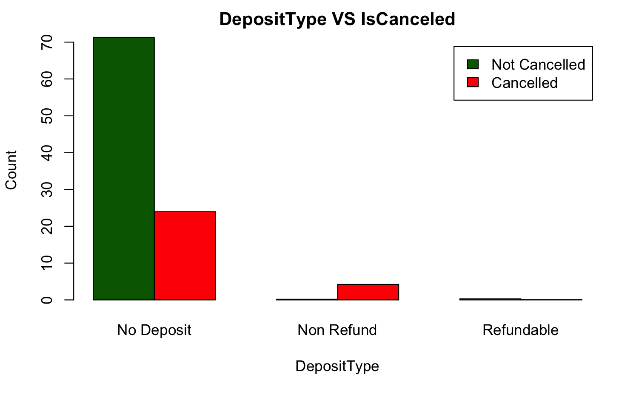
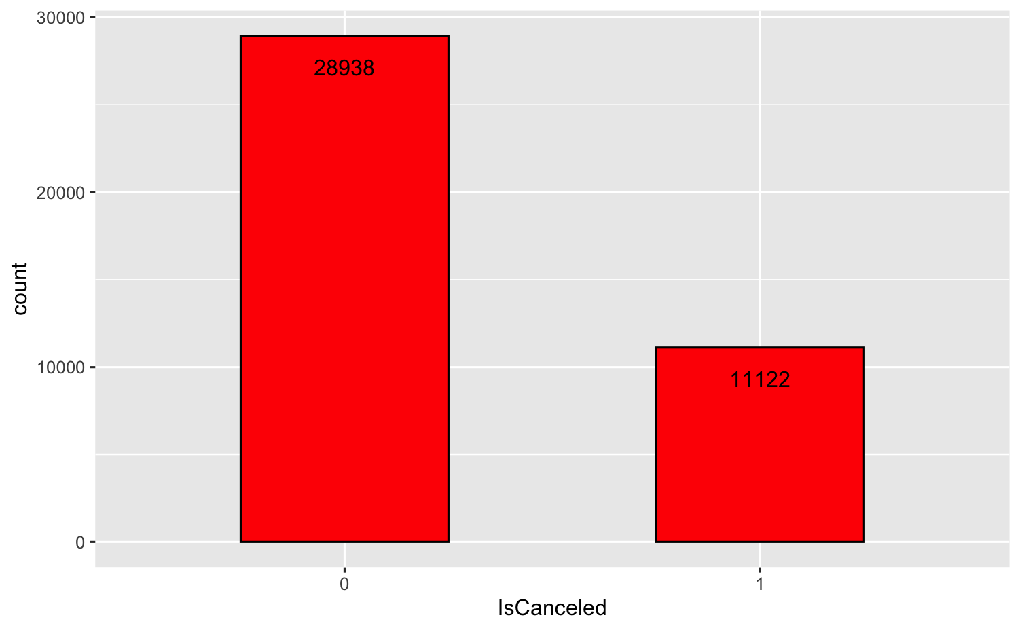
Likelihood to Cancel
About 30,000 of customers with reservations do not cancel
About 10,000 of customers cancel their reservations
95% of customer tend to cancel the reservation despite the deposit type being non-refund.
Notes:
Even though we have less number of people choosing non-refundable deposit type.

Slide 5
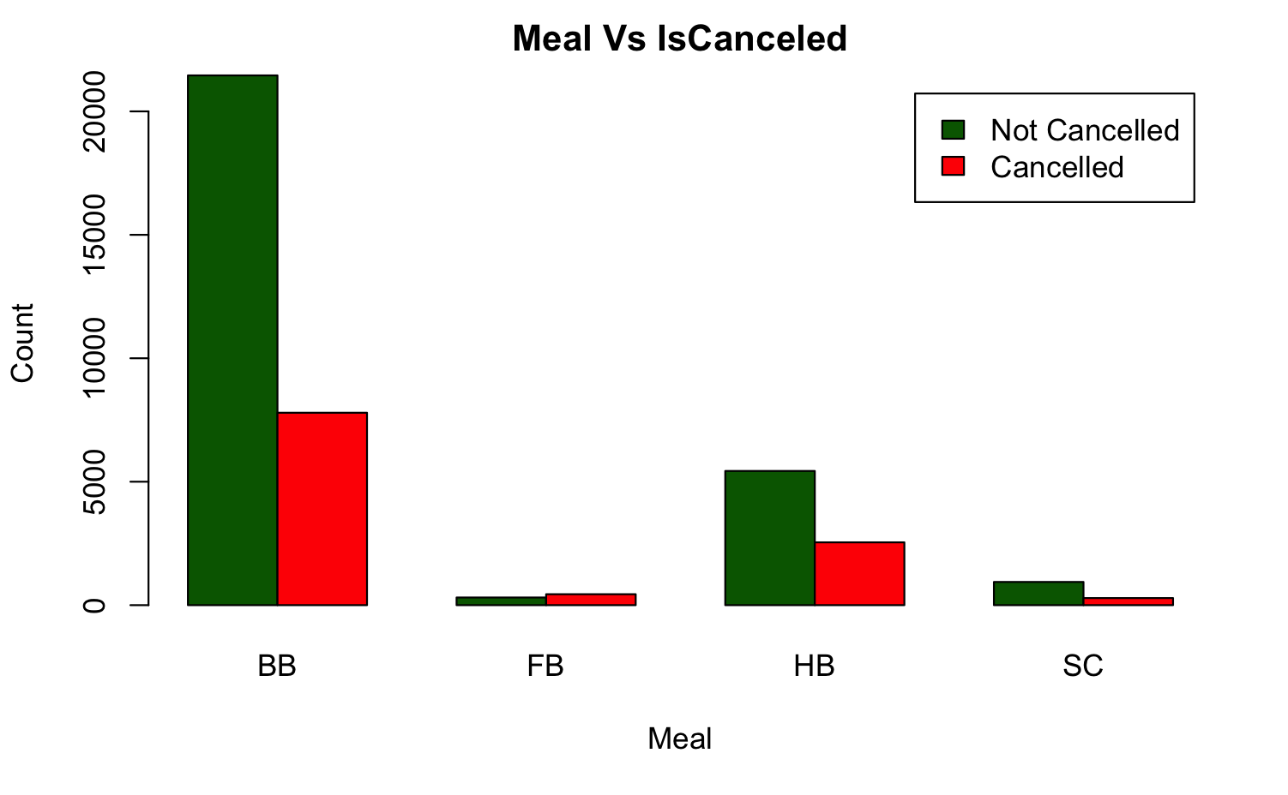
Meal Plans
Approximately 26% of BB meal type chosen customers tend to cancel the hotels.
58% of FB meal type chosen tend to cancel the hotel reservations.

Slide 6
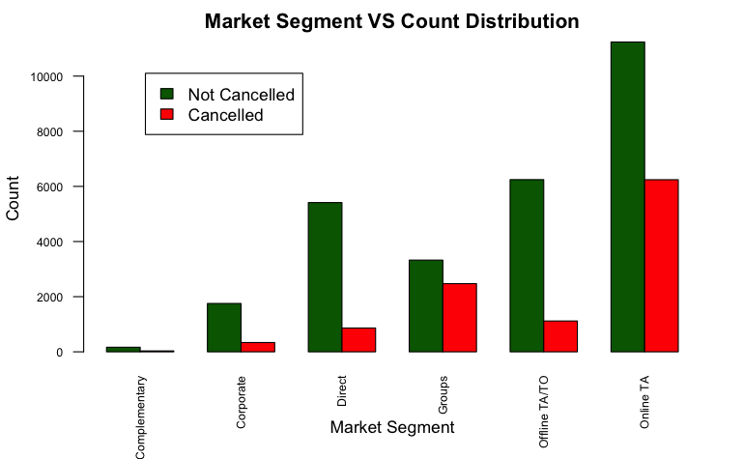
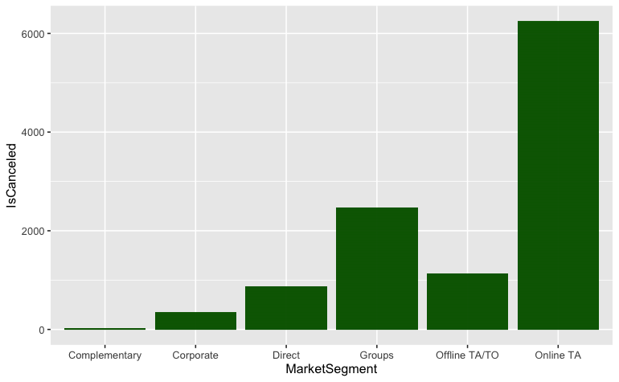
Market Segment
Over half of the reservations are made through online travel agents
Around 42.6% of customers belonging to Groups market segment tend to cancel the reservations.

Slide 7
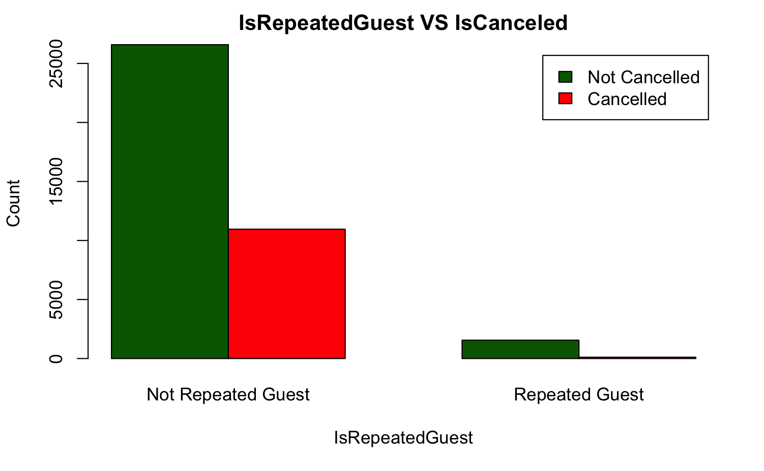
Repeated Customers
For a given dataset, we have a less number of repeated customers.
29% of Non-repeated guests tend to cancel the reservations.

Slide 8
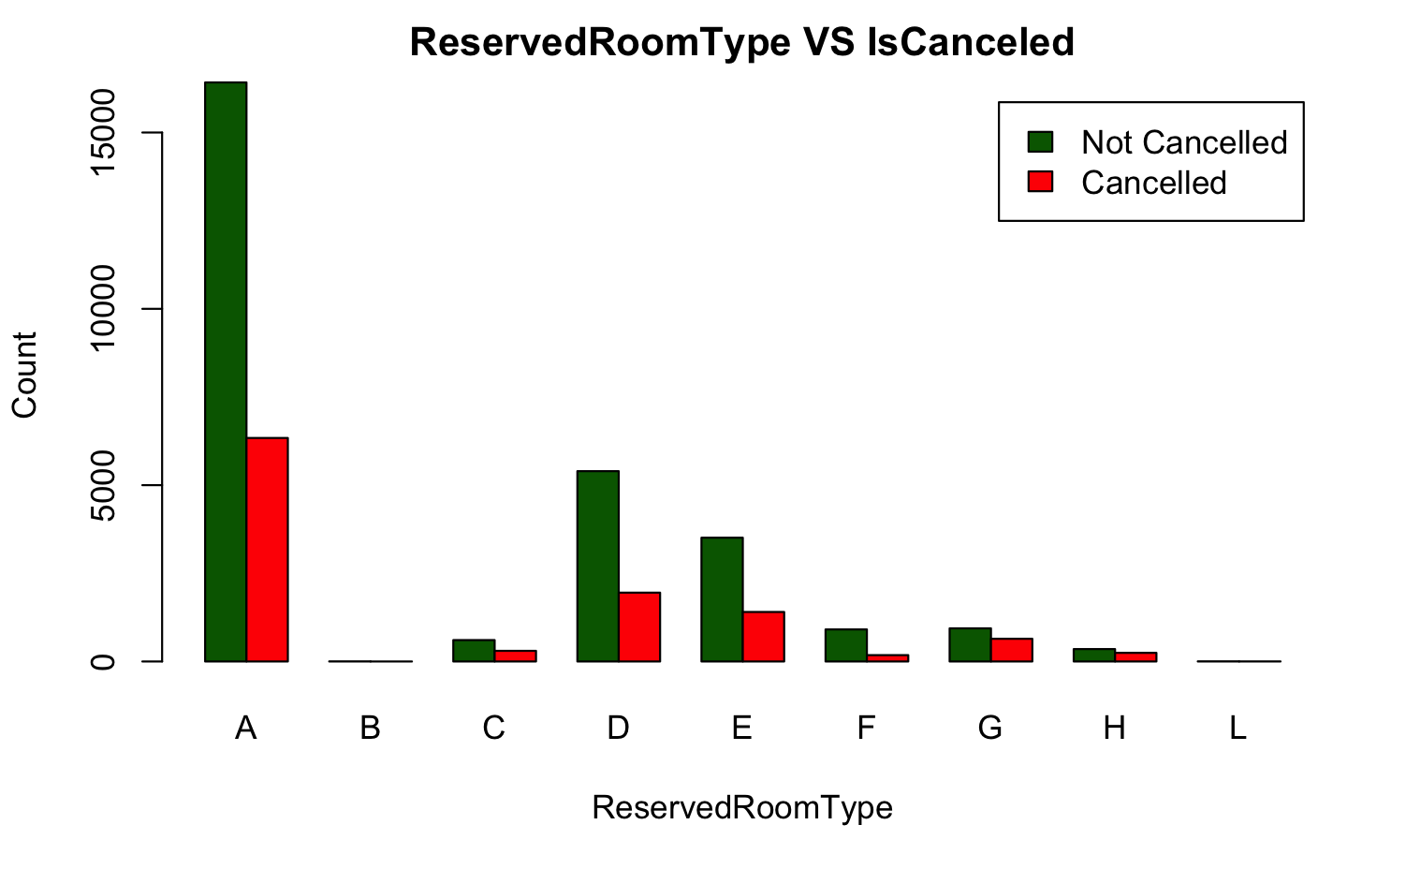
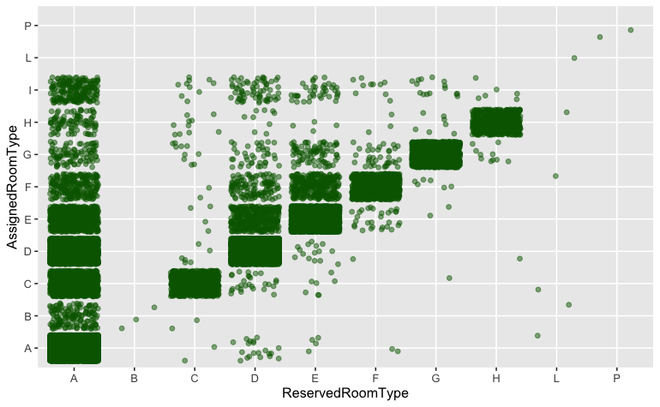
Reserved Room Types
The demand for room type A is the highest
27.5% of customer who reserved room type A are more likely to cancel the reservation.

Slide 9
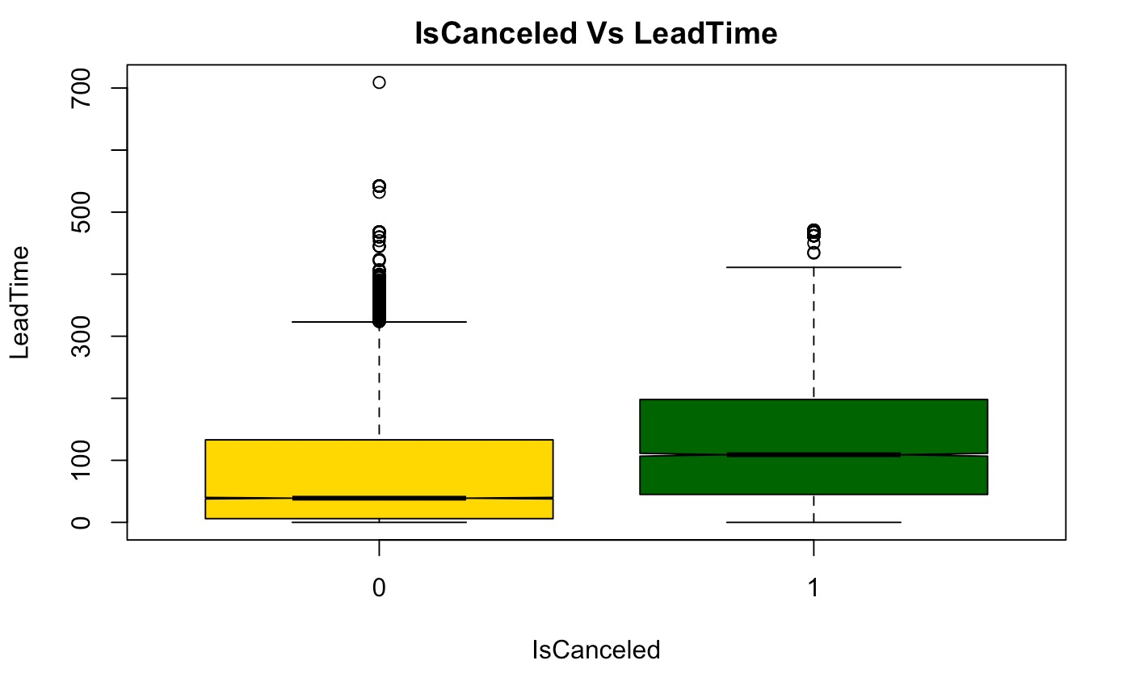
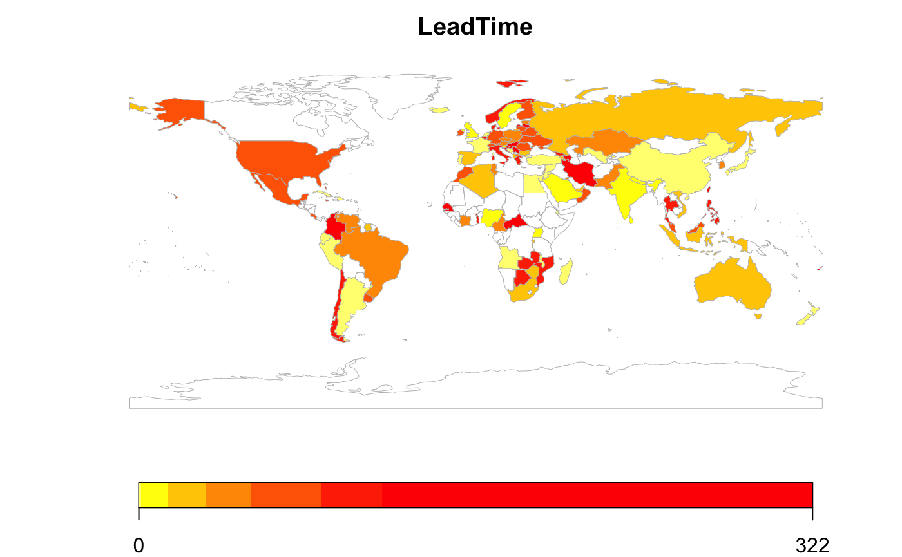
Lead Time and Cancellations
From this graph, you can see that the longer the lead time, the more likely a customer is to cancel.
In this map, you can see which countries are booking with the highest lead time.

Slide 10
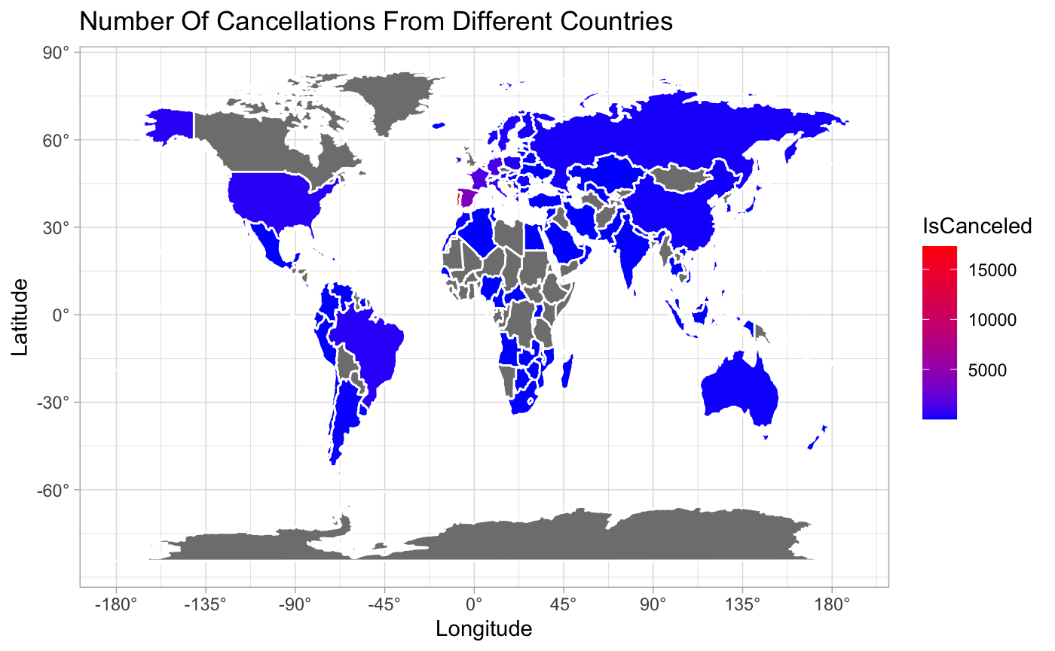
Cancellation Based on Countries

Slide 11
Factors affecting cancellation
The more lead time the more likely the customer would cancel their reservation.
Non-repeated guests are likely to cancel their booking.
Group customer type has the highest cancellation.
Non-refunded customer type tend to cancel their reservation more often.

Slide 12
Data Modeling
Based on our analysis, we created two machine learning models to predict the future cancellations.
Based on the incoming data, our model has 82% percent chances of correctly predicting whether the customer will cancel their reservation in the future.

Slide 13
Recommendations
Even though cancellation for the non-refundable deposit type is higher, we have more customers choosing no-deposit. We need to concentrate on no-deposit customer type.
26% of BB meal type are likely to cancel and BB type being the highest chosen meal type. We can upgrade their meal plan from BB to FB or HB.
Since we have more customers choosing online travel agents, hotel can try to reduce the brokerage charges.
For this particular hotel, we have more customers from Portugal who are likely to cancel their reservation. We need to survey the customers and try to increase their experience.

Slide 14
Future Scope
We can further continue the analysis and improve the prediction of reservations cancellation by leveraging the reviews data with the help of text analysis.
We can build models using state of the art deep learning techniques to further improve the accuracy of predictions.

Slide 15
Thank you

